Slide 1
T+2 in CAnada
Industry Readiness, Preparation, Schedule

Slide 2
Agenda
What is T+2/Canada’s Move to T+2
T+2 Stakeholders
Products Affected by T+2
T+2 Timeline
T+2 Preparedness
Considerations
Custodians
Buy side/investment and mutual fund managers
Sell side/dealers
Summary

Slide 3
What is T+2?
T+0, T+1, T+2, T+3 refers to days to settle following trade execution
T+2 = trade date + 2 days
T+2 = Short-hand for industry-wide initiative led by CCMA to condense maximum standard trade-to-settlement cycle from T+3 to T+2

Slide 4
Canada’s Move to T+2 – Benefits
Reduced counterparty risk
Risk that a party to a trade fails to deliver cash or a security is one day less
Increased global settlement harmonization
Expected decreased margin, liquidity, clearing capital requirements
More efficient, safer, better service… for institutional and retail investors

Slide 5
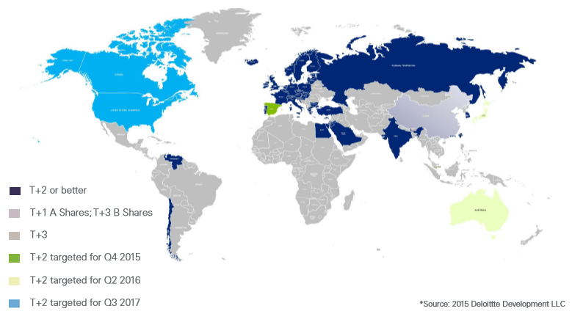
Canada’s Move to T+2 – Other Markets
T+2 in 2017
T+2 pre-2016
T+2 March 2016

Slide 6
Canada’s Move to T+2 – North America
U.S. announced transitioning to T+2 in 2017
Practically, Canada must change on same day
April 2015: Canadian Securities Administrators (CSA) fully support Canada’s move (Staff Notice 24-312)
Substantial cross-border activities: Canada must align to U.S. schedule
Follows Europe’s move to T+2 in Oct. 2014 and Australia/New Zealand move in March 2016
Endorses CCMA to co-ordinate

Slide 7
Canada’s T+2 Stakeholders – CCMA
CCMA = Canadian Capital Markets Association
Launched 1999; communicates, educates, helps co-ordinate cross-capital-markets projects
Initial projects were:
T+1 → STP (straight-through processing)
National Instrument (NI) 24-101
‘Moth-balled’ in 2008
Small board (CBA, CDS, IIROC, TMX)
Today’s priority: T+2

Slide 8
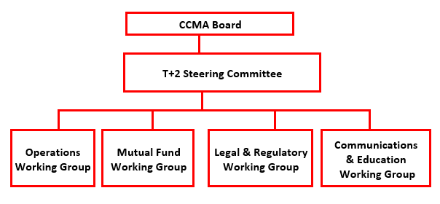
Canada’s T+2 Stakeholders – CCMA

Slide 9
Canada’s T+2 Stakeholders – Other
Associations (IFIC, IIAC, ACPM, CBA, others)
Major infrastructure
Canadian Depository for Securities
Fundserv
Exchanges, alternative trading system
Service bureaus, back-office providers, vendors
Custodians
Buyside: Investment managers, portfolio managers
Sell-side: IIROC, MFDA, exempt market dealers

Slide 10
Products Affected by T+2 – High Level
T+2 for all assets currently settling on T+3 standard
Equities
Corporate and long-tem government bonds
Mutual funds
Not affected
T-bills – already settle as quickly as same-day (T)
Money market mutual funds and options (T+1)
Short-term federal government bonds (T+2)
New issues, ‘special terms’, not ‘regular way’

Slide 11
Products Affected by T+2 – Details
CCMA Canadian T+2 Asset List
Final version posted on www.ccma-acmc.ca
Sections for securities that are traded (capital markets/exchange) or bought/redeemed (funds)
U.S. Asset T+2 List
Similar assets, revision to list in T+2 Playbook underway
Visit www.ust2.com/

Slide 12
T+2 Timeline – Canada/U.S. Schedule
U.S. and Canadian schedules align
U.S. | CANADA
Oct. 2012: DTCC-commissioned BCG report showed positive benefit-to-cost ratio from shortening settlement cycle Apr. 2014: All major U.S. industry organizations commit to move to T+2 | Jan. 2008: CSA NI 24-101, Institutional Trade Matching and Settlement, required reporting to regulators if less than 90% of North-American trades matched by noon on T+1
June 2015: Updated U.S. T+2 white paper; all major U.S. industry organizations commit to move to T+2 | July 15, 2015: CCMA “re-activated” for T+2 Sept. 2015: CDS white paper on T+2 issued
Dec. 2015: Industry proposal to SEC | Dec. 2015: CCMA relaunched and staffed; milestones ready; industry awareness builds
2016: DTCC and key infrastructure to develop, test systems changes, develop test plans; firms start changes | 2016/Q1 2017: CDS and key infrastructure to develop, test systems changes and finish cross-industry test plan; firms start changes
Q1-Q3 2017: Firms finish changes; U.S. industry testing; readiness confirmed | Q1-Q3 2017: Firms build, Canadian industry testing, confirmation of readiness
Sept. 5, 2017: Implementation
Notes:
SRH: **Will Canada’s proposed schedule be similar to this one?

Slide 13
T+2 Timeline – Canada
Summer 2016 | Late Summer 2016 | Fall 2016 | Year-end 2016 | Spring/ Summer 2017 | Sept. 5, 2017
Detailed industry-wide test plans issued by CDS, Fundserv, and U.S. | Requests for comments issued by regulators | Replies to regulatory consulta- tions due | Target: finish builds | Industry utility test environ-ments open | Go live!
✓
✓
“Go/
No Go”
Decision
Formality
4-6 weeks pre-Sept. 5

Slide 14
T+2 Timeline – How to interpret
Understand implementation date has two parts:
Sept. 5: first day trades made for T+2 settlement
Sept. 7: last day trades settle T+3, first settle T+2

Slide 15
T+2 Preparedness – How ready?
First step: look at timing of trades entered and matched
Trades… | Entered T | Entered Noon T+1 | Entered T+1 EOD | Matched T | Matched Noon T+1 | Matched T+1 EOD
June ’07 | 52% | 76% | 84% | 23% | 55% | N/A
Dec. ’09 | 71% | 90% | 94% | 45% | 85% | 90%
Dec. ’11 | 78% | 92% | 95% | 50% | 87% | 92%
Dec. ’13 | 79% | 89% | 92% | 50% | 88% | 92%
Dec. ’15 | 81% | 95% | 97% | 54% | 90% | 94%
Improved ’07 to ’15 | 56% | 25% | 15% | 135% | 64% | N/A
Worry about these 5% and 6%!

Slide 16
T+2 Preparedness – Key issues
Utilities, service bureaus, vendors expect to be ready
100+ issues identified by industry members
Two primary issues
Readiness – what does it mean? Will buy side be ready? (it’s dispersed, no single association)
Testing – what kind of testing will be sufficient? Mandatory? Scripted? Certified?
See www.ccma-acmc.ca, Committees for issue lists

Slide 17
Considerations – General
Map all current downstream and upstream processes to find steps to reduce or accelerate
Review impact on reports, files and databases
Make changes to trading, portfolio valuation, cash management, other systems
Make changes to reports, prospectuses, contracts
Check suppliers are T+2-aware, will be ready, tested
Consider impacts on institutional and retail clients
Penalties?
Stay on top of industry T+2 efforts

Slide 18
Considerations – Custodians
Essentially ready: largest have flexibility to deal globally, especially with Europe’s move to T+2
Current efforts focus:
Work with buy side to identify processing flaws
Eliminate securities processing redundancy, increase efficiency support to meet NI 24-101
NI 24-101 expected to require matching of at least 90% of ALL trades by volume and value by noon on T+1
Get the word out – inform clients about T+2

Slide 19
Considerations – Buy Side/Managers
Learn lessons from Europe, Australia, New Zealand
Engage senior management
Assign corporate-wide project status and monitor
Leverage U.S. Playbook
Explore whether current irritants will become showstoppers due to shorter timelines
Holiday processing
International client allocations/communications
Get involved directly or through your association(s); sign up for free CCMA newsletter, notices

Slide 20
Considerations – Buy Side/Managers
Portfolio management
Misaligned cycles may create funding shortfall
Cost of credit to cover mismatches at transition
 How will move to T+2 affect cash management
Policy
Retail clients, private clients, institutional
Segregated cash flow timing
Pooled fund subscriptions and redemptions
 Seg accounts  bad impact borne by client pooled funds  must meet best interests of all

Slide 21
Considerations – Buy Side/Managers
Operations
Less time to notify of/receive corrections from sub-advisors in different time zones
Less time to fix mistakes, direct FX movements,
Less time to recall lent securities
Less time for designated brokers to manage ETF unit creation and redemption
Check accrued interest calculations, implications re corporate actions, dividends
 Work with custodians, broker/dealers, service providers and vendors

Slide 22
Considerations – Buy Side/Mutual Funds
Mutual fund and segregated fund companies, distinct from IIROC or MFDA dealers in funds
Segregated funds not ‘securities’ but follow standard settlement cycle for mutual funds
Fundserv links ‘manufacturers’ and ‘distributors’
Minor impact on Fundserv Standards, systems
Key issues are:
Approach to testing – v27 (June) + T+2 overlap
ID’ing which funds are changing – should be all

Slide 23
Considerations – Sell Side/Dealers
Trade reconciliations – reduced timelines
Holiday processing
International client allocations/communications
Physical securities
Key infrastructure:
CDS (see CDS White Paper)
Service bureaus and back-office providers (Broadridge, IBM, IFDS, NBCN, intermediaries)
Vendors

Slide 24
Summary
Canadian markets must go to T+2 same day as U.S.
Firms must cut steps and/or compress processes
Most agree systems will be minimally impacted
Canadian firms and marketplace well-positioned to meet September 5, 2017 date
Don’t let this lull you into false sense of security
Biggest issue likely behavioural
CCMA ED Keith Evans part of UST2 Command Centre confirming “Go/No Go” mid-/end-July 2017
Stay informed and participate!

Slide 25
Information Sources & Questions
ww.ccma-acmc.ca
FAQs – updated periodically
Newsletter – sign up for free
T+2 Readiness Self-Assessment Checklist
T+2 Asset List
Industry survey results
Investment manager checklist
Testing information
www.ust2.com
Playbook
Testing updates and other tools

