Slide 1
Shortening Settlement to T+1
NOTE TO USERS: This generic presentation has been prepared to help firms provide general T+1 project background to staff who may be brought onto the T+1 project team later, for example, for testing and implementation. Users are encouraged to edit and tailor messaging to their firm’s requirements.
This presentation is wordier than typical because the extra words:
Will help people giving the presentation, who can easily remove unnecessary text.
May make material easier to understand for those who read, rather than receive, the presentation.
As the priority issues are resolved, and if any new issues arise, additional slides (or an updated presentation) will be made available.
Date

Slide 2
Agenda
What is T+1 and why does it matter?
Six challenges to reaching T+1
Issues addressed so far
Major issues still to address
What about transition?
What we’re doing right now
[insert additional sections as desired]

Slide 3
What is T+1 and why it matters

Slide 4
What is T+1?
T+2, T+1, T+0 refer to the number of business days it takes to ‘settle’ a trade – that is, exchange securities for payment – after trade execution
T+2 = trade date + 2 days – the current standard for securities except money market instruments
T+1 = trade date + 1 day
And it’s short-hand for the Canadian industry initiative to shorten settlement to T+1

Slide 5
Why and why now?
Partly tackling 2021 Gamestop/Robinhood market volatility
Benefits:
Less counterparty risk (that trade party can’t deliver cash, security)
For dealers: less margin, liquidity, clearing capital requirements
For institutional & retail investors: more efficient, safer, better service
BUT benefits and costs among industry participants unequal
Transition: Canada & U.S. wanted Labour Day 2024 weekend, but:
U.S. regulators set May 28, 2024 U.S. long weekend
Canada set May 27, 2024 to migrate due to risk

Slide 6
Why must Canada move to T+1?
Canada and the U.S. moved to T+5, T+3, and T+2 together
~25% of transactions and 40% of value traded in Canada are in interlisted securities – listed on Canadian and U.S. exchanges
Study showed Canadian markets should keep on same cycle as U.S. or lose business
Canadian participants must change either way – either to:
Match the shorter U.S. settlement cycle OR
Change systems/process to accommodate different U.S. cycle

Slide 7
6 challenges to reaching T+1

Slide 8
Challenge 1 – What a difference a day makes
From T+5 to T+3 to T+2 – ‘easy’; from T+2 to T+1 much harder:
Less time to provide allocations
No day between trade and settlement to fix errors via batches
For T+1 trades in different currencies, there will be a mismatch with major currencies (except CAD/USD) that settle T+2
Less time to initiate recalls/find alternative securities to borrow
Liquidity, timing problems with ETF create process
Extra complexity as North America at ‘end’ of global trading day
Can’t just do more faster; must change systems/processes

Slide 9
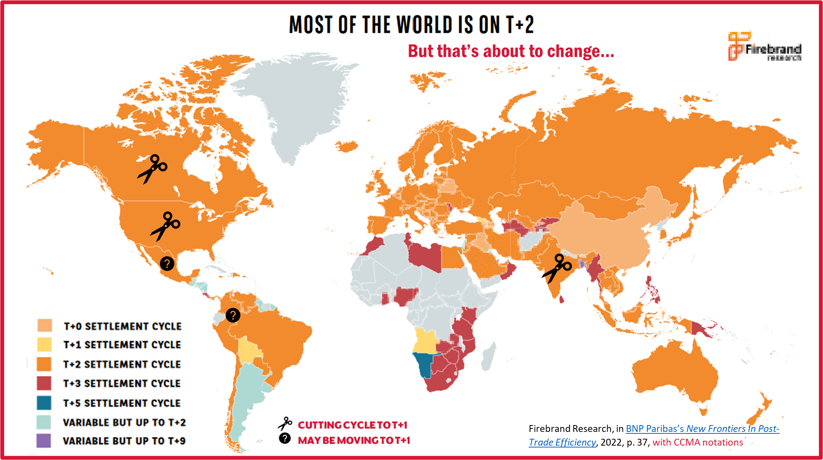
Challenge 2 – North America is ‘deharmonizing’
Instead of joining Europe, Asia (as in T+2 move), we (U.S., Canada with Mexico) are leaving most other countries behind

Slide 10
Challenge 3: Regulatory issues – U.S.
U.S. regulator (SEC) took > a year to set date, left a year to go
Unlike 2017 move to T+2, SEC didn’t listen re transition date
SEC said intent to shorten settlement to T+0 is off the table… for now; no clarity on timing re T+0 delayed industry participant decisions
T+1 goal is less risk, but delays/uncertainty may increase fail risk that trade won’t settle if money or security can’t be delivered
Fails currently ~2% in Canada and U.S.

Slide 11
Challenge 3: Regulatory issues – Canada (cont’d.)
Industry says 90% of trades should match by 3:59 a.m. ET T+1 to:
Maximize flexibility for Canadian participants nationwide (firms also can choose to adopt DTCC’s 9 p.m. ET on T matching)
Help counterparties operating in non-Canadian time zones
Allow custodians and buyside firms more time to affirm trades
Better enable sell-side firms to manage collateral/settlement/etc.
CSA Staff Notice 24-319 cites intent to recommend 3:59 a.m. T+1
National Instrument (NI) 81-102 Investment Funds NOT changing; likely won’t know until next year what mutual funds will move to T+1

Slide 12
Challenge 4: We’re far from matching goal
Some progress 2021 to 2023, but a long way to go
# entered/allocated on T must increase 30%; $ must rise by 25%
# matched must double or triple; $ must rise by 50-60%

Slide 13
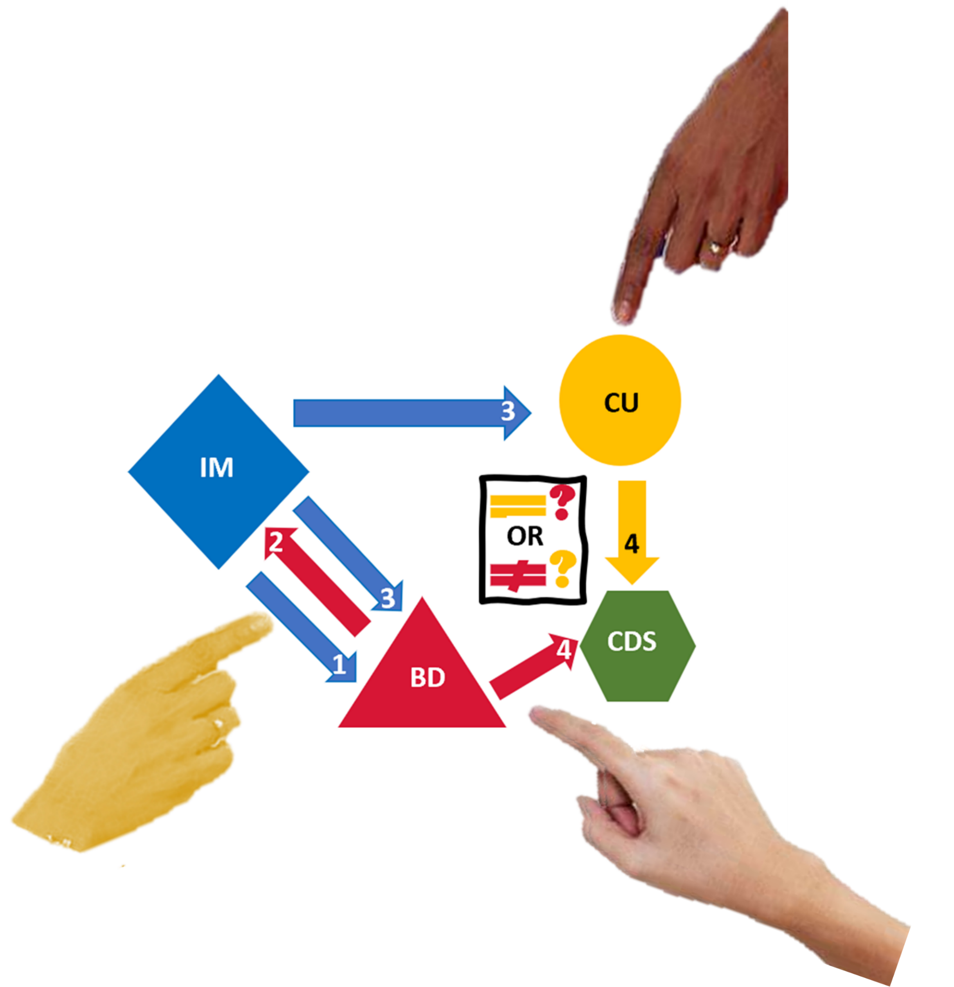
Challenge 5: Blame game
Exchange trades not likely a problem, institutional trades are
Three parties to an institutional trade:
Is Broker/Dealer trade entry late?
Is Investment Manager allocation late?
Is CUstodian confirmation late?
Are funds/securities available for
release on time (BD/IM/CU)?
Are securities loan recalls or FX to blame?
Competitors must collaborate
… or settlement chain breaks
IM sends order to BD
BD advises IM of fill
IM provides allocations to BD and CU
BD and CU records of IM trade/ allocations match or not at CDS

Slide 14
Challenge 6: Not much time to automate
Where is our firm on this timeline?
What are our dependencies on third parties?

Slide 15
All eyes on transition (dates)
and Mexico!

Slide 16
Are these challenges solvable?
Yes, with ….
AUTOMATION
AUTOMATION
AUTOMATION

Slide 17
Issues addressed so far

Slide 18
Issue logs used to identify/solve issues
Industry-wide issue logs on Canadian Capital Markets Association (CCMA) website
CCMA: An umbrella group of financial associations, industry participants, infrastructure (marketplaces, CDS, CDCC, Fundserv), service providers, vendors, with regulators
CCMA role: Launched in 1999; communicates, educates, helps co-ordinate cross-capital-markets projects
CCMA T+1 Steering Committee; operations, mutual funds, legal/ regulatory issues, communications/education subcommittees
Follow CCMA on LinkedIn; sign up for monthly newsletter/update info@ccma-acmc.ca; visit FAQs on www.ccma-acmc.ca)

Slide 19
Scheduled activity changes
CDS Job Scheduler/Timeline
Hourly 10 a.m.-4 p.m. T: Marketplaces submit trades
(currently end-of-day)
Hourly 11 a.m.-5 p.m. T: CDS returns exchange-trade messages/files
(currently end-of-day)
By 7:30 p.m. on T: BDs enter allocated ITP trades
By 3:59 a.m. T+1: IMs/BDs/CUs confirm ITP trades

Slide 20
What securities will move to T+1?
Canadian Asset List on ccma-acmc.ca; for U.S., dtcc.com/ust1
All non-fund securities currently settling on T+2 standard
Equities and other platform-traded securities (e.g., ETFs)
Government and corporate bonds
Derivatives
Not affected
T-bills – already settle same-day (T)
Money market mutual funds, options – already settle T+1/T
New issues, ‘special terms’, not ‘regular way’
Mutual funds? – Unknown… more later

Slide 21
Funds may/may not go to T+1?
Unknown – mutual funds, segregated funds, other funds
CSA Staff Notice 81-335 Investment Fund Settlement Cycles said T+1 not mandated for mutual funds
Recognized T+1 mismatch challenges for some funds
Wanted to provide flexibility for manufacturers to decide
CSA staff believe many Canadian mutual funds will be able to settle distributions and redemptions on T+1
Staff said “…where practicable, mutual funds should settle [mutual funds] on T+1 voluntarily.”
Fund managers to decide which funds move to T+1
44% of mutual funds have at least 10% holdings in securities that will continue to settle on T+2; the uncertainty is unsettling

Slide 22
Funds may/may not go to T+1?
Whether fund manufacturers move just some or most funds to T+1, Fundserv will be ready

Slide 23
8 major issues still to address

Slide 24
8 (now 7) Priority issues
Resolved NI 24-101: CSA staff to recommend T+1 rule be amended to require 90% of trades match by 3:59 a.m. ET on T+1
Trade pre-match, correct, allocate, confirm: These processes must be condensed a lot for T+1 to avoid more fails
Securities lending: Securities loaned may need to be recalled to facilitate settlement; adapt process for T+1 or fails and costs grow
Foreign exchange: Spot FX settles on T+2 convention for major currencies (except CAD/USD on T+1); currency/security settlement mismatch risks increased costs and fails
ETF creation process: If ETF creation in primary market fails, ETF trades in secondary market will also

Slide 25
8 (now 7) Priority issues (cont’d.)
Industry T+1 test plan: Bilateral/industrywide unscripted and scripted testing is complex, but critical
Ex-date processing during T+1 transition: High-volume and/or complex entitlement transactions may cause transition issues
Conversion weekend backout plan: T+1 harder, with day to ‘fix’ things lost; Canada has one day less due to U.S. having a long weekend; SEC hasn’t provided for a formal go/no-go decision
Note: Priority #2 is up to participants and counterparties/ vendors/infrastructure; #3 to #8 require cross-industry efforts

Slide 26
Priority #3 – Securities lending
Securities lending systems are disjointed
Loan recalls identified as the major obstacle
Market practice is to recall by 3 p.m. ET on T+1; will be 3 p.m. on T to allow borrowers last trading hour to process recalls and/or determine if they need to buy back securities
TMX/CDS is developing a Recall Portal
For use by CDS participants and non-CDS members
Interoperable with vendor systems (Equilend, Pirum, etc.), and internal systems used by parties to a securities loan
Expected to be implemented next year before T+1 transition

Slide 27
Priority #3 – Foreign exchange
There are custodians and others that can help address the mismatch between currency settlement on T+2 and trade settlement on T+1
BUT this is still expected to be a problem
High demand at end of day of even CAD/USD may lead to liquidity squeezes
Process changes to book FX on T?
Industry solution?

Slide 28
Priority #6 – ETFs
Secondary market will be T+1, following marketplace Rules
Creation/redemption process under NI 81-102:
Focus on ability to provide collateral as part of creation process
Working with CSA to obtain blanket exemptive relief
Longer term, Canadian ETF Association will:
Ask the CSA to update rules to codify exemptive relief
Investigate possibility of automating creation/redemption processes through CDS (similar to what DTCC does in U.S.)

Slide 29
What about Transition?

Slide 30
Ready or not for May 27, 2024?
Canada will transition with U.S.; no delays unless SEC says so
Risks of not being ready
Increased failed trades
Increased costs
Market impacts
Unhappy clients and regulators
How to minimize risk
Automate and test, test, test
Get in extra staff
Allow for greater liquid assets/lines of credit

Slide 31
What we’re doing right now

Slide 32
What is [insert firm name] doing?
Reach out: Up- and down-stream to discuss where to cut or compress steps
Technology: Autoconfirm/match/correct on T – look at process, technology, outsourcing solutions for Canadian and U.S. timelines
Portfolio management: Misaligned cycles = funding issues
Prefund/arrange credit to cover mismatches (but higher costs)
Plan for extra credit/liquidity to cover mismatches at transition
Documentation: Check if any have unworkable timelines for T+1; if needed, update trade-matching statement, other agreements, client contracts

Slide 33
What is [insert firm name] doing?
Operationally: Look at different alternatives to address:
Less time to send/receive sub-advisor corrections
Less time to recall securities on loan
Less time to instruct/correct FX
Process changes:
Participants: Consider extending workday so all allocations sent/trades processed before staff leave or shift work elsewhere
Dealers/service providers: Look at running trade reconciliations intraday to identify and fix breaks on T
Dealers: Be able to create/process on T to settle on T+1

Slide 34
Where is the overall industry now?
Despite greater concerns re ability to transition smoothly to T+1 vs T+2 due to greater T+1 complexity and short remaining time
Industry survey results show advances in T+1 planning, development, and testing preparation since survey last year
3:59 decision means participants can advance decisively now
More service provider solutions coming to market
CDS and Fundserv confident they can successfully facilitate testing and transition
“Failure is not an option” (Apollo 13): Canadian capital market participants have shown again and again the ability to deliver

Slide 35
[Insert firm specific messaging]

